Slide 1
Water as a Mixture

Slide 2

By the end of this Smart Lesson, you should be able to:
Explain where we source water from in Australia.
Outline the potential sources of water contamination.
Compare different water sources and analyse their importance.

Slide 3
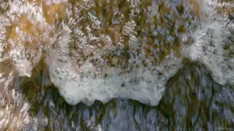
In science, we usually refer to water as a pure substance made entirely of water particles.
However, most water that you will drink, see and use in real life is actually a mixture of many different things.
For example, the tap water you drink contains dissolved oxygen and other gases from the air, minerals from the rocks and soil it has passed through and chemicals to kill bacteria.

Slide 4
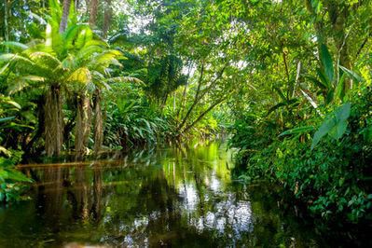
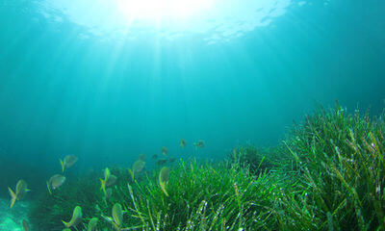
Lake and river water contains many different substances.
These can include: dissolved gases, bacteria, suspended dirt, fish, yabbies, plant matter and other things which end up in open water. This is why we treat water before it reaches people.
Seawater contains even more junk. It is salty because it contains a large amount of dissolved salt (making a salt solution). It also has suspended sand and many living organisms.

Slide 5
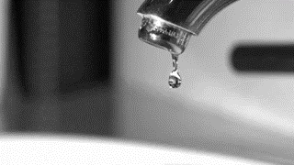
Water is taken through several important cleaning processes before it reaches your taps, meaning it will be safe to drink.
The contents of your tap water depend entirely on their origin and treatment.
In some areas, water quality can be a problem due to changes in supply or failed treatments. In this case, water filters are used to filter out impurities before you drink them.

Slide 6
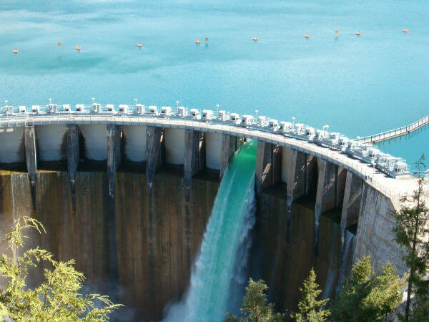
The majority of Australia's water is sourced from lakes and rivers.
The water is often collected by dams, which hold the water in artificial lakes or reservoirs. This water travels across large stretches of land before reaching treatment plants, picking up a lot of substances in the process.
Some of these substances become solutes in the water solvent, while others become suspended in water.

Slide 7
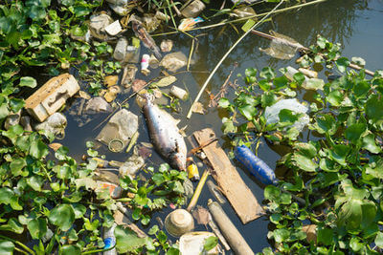
Lakes and rivers can contain living organisms (such as fish and plants), soil particles and rubbish from towns and cities.
These are all suspended in the water.
There are also dissolved metals (iron, copper, calcium) and chemicals (chlorides, carbonates and nitrates) which can leach from the rocks or are released into rivers by factories and drains.

Slide 8

A lot of water isn't found in rivers or lakes - it is actually found in the ground.
This is called groundwater. Rainfall soaks into the earth and builds up deep down in the soil and some types of rock. Rocks that let water into them are called pervious rocks. Other types of rock do not let water pass through them, acting like a raincoat layer inside the soil. These are impervious rocks.

Slide 9
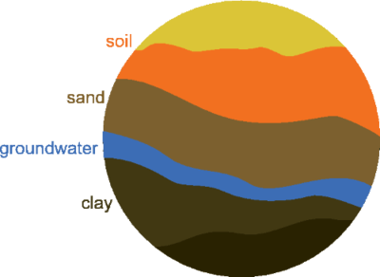
The earth forms layers of pervious rocks and impervious rocks.
A pervious rock layer that has absorbed water is called an aquifer.
We can often find aquifers deep underground between layers of impervious rock. Water that is taken from an aquifer is called artesian water.

Slide 10
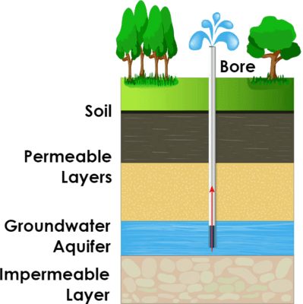
The water table is the name of the top aquifer layer in the soil.
If it lines up with the top of the ground, it becomes a lake or river.
We can use groundwater in the same way that water from rivers and lakes is used. We bring it to the surface by pumping it up through a bore, which is a drilled hole.

Slide 11
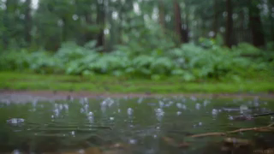
Groundwater usually contains a large amount of different salts, like sodium chloride and manesium chloride.
It also will often contain many metals and minerals, as well as rock particles like clay.
These can do a lot of damage to pipes and can make the water unsuitable for drinking. Therefore, groundwater also needs to be purified before it can be used.

Slide 12
The largest aquifier in the world may be under you right now!
The Great Artesian Basin exists underneath almost a quarter of mainland Australia.
In some places, it is 3 km deep and it may contain over 65,000 km3 of water. The aquifer travels under most of Queensland and it extends into neighbouring states as well.

Slide 13
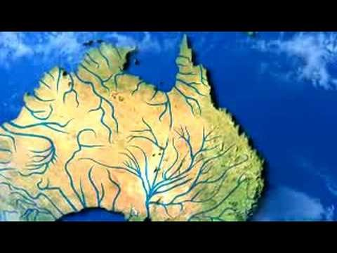

Slide 14
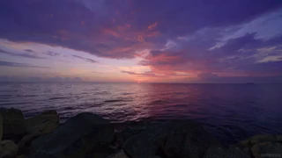
Rainfall is declining in many parts of Australia as the climate changes.
As a result, rivers, lakes and groundwater may not be able to supply all of our water needs in the near future. But surrounding us is a massive, unused source of water - oceans!

Slide 15
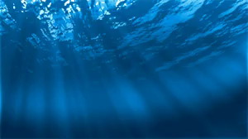
There's just one problem.
Ocean water is so salty that drinking it makes us lose more water than we ingest. Drinking a lot of seawater can be very bad for you.
We need a way to get rid of the salt before we can drink seawater.

Slide 16
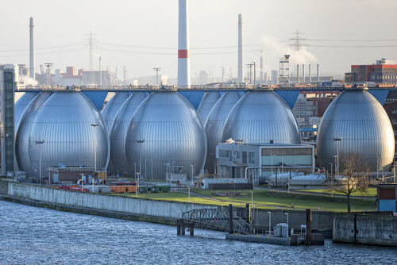
We can make fresh water from the oceans (as well as some salt lakes, like Lake Eyre) using a process called desalination.
Desalination is the process of removing salt from a solution, usually water. There are several methods of desalination.
You can distil water to remove salt, but it is expensive to do so on a large enough scale to provide drinking water.

Slide 17
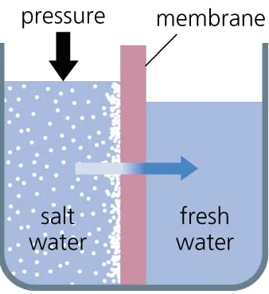
A newer method of purifying salt water is a type of filtration called reverse osmosis.
Salt water is pushed through a very fine membrane that only water particles can pass through - no salt particles are able to travel with the water.
This leaves behind the salt and brings out fresh water that can now be consumed.

Slide 18
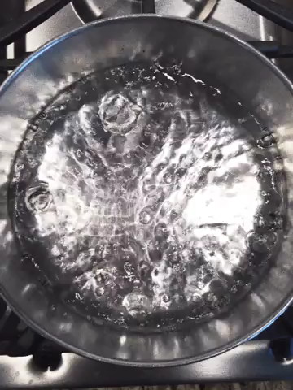
When water is safe to be drunk, we call it potable water.
If it is unable to be drunk safely, it is unpotable.
If you want to drink water straight from the source (a river, lake or spring), boiling it is usually enough to make it potable. Boiling water is hot enough to kill most bacteria.

Slide 19
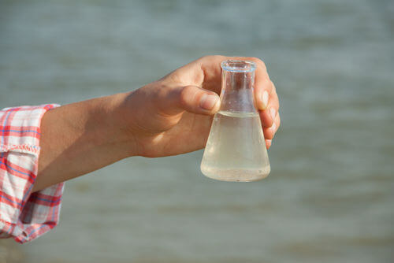
Water that you drink and wash with needs to be clean and free of harmful substances.
As explained previously, suspended and dissolved substances are common in natural water sources.

Slide 20
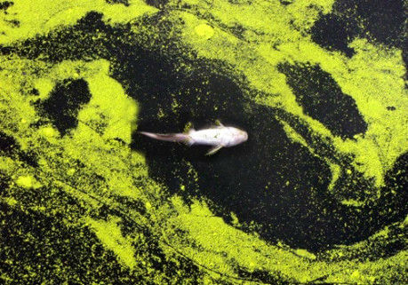
Water contaminants common to all sources of water are:
Various kinds of life and the waste that that life creates. Faeces and other wastes often contain diseases.
Algae can bloom in still water sources and will often be poisonous or make the water taste bad.

Slide 21
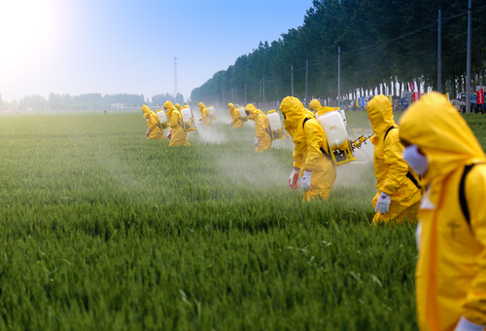
Water contaminants
Pesticides and farm-runoff can often enter waterways from nearby farms, and detergents or poisons will often be washed into water from towns and cities.
Metals like iron are also dangerous to have in water, while calcium and magnesium make water 'hard'. Hard water is difficult to lather with, making bathing and washing difficult.
Salt is found in salt lakes and the ocean - both make water unpotable.

Slide 22
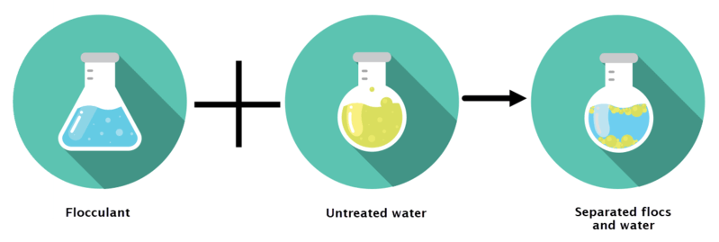
Water that you get from your taps is treated to make it potable.
To remove colloidal and suspended particles like dirt and clay, a chemical called a flocculant (usually the metal alum) is added.
This chemical causes the suspended particles to stick together, forming clumps called flocs which separate out of the mixture - this process is called flocculation.
The flocs can be skimmed off the top of the water or sink to the bottom.

Slide 23
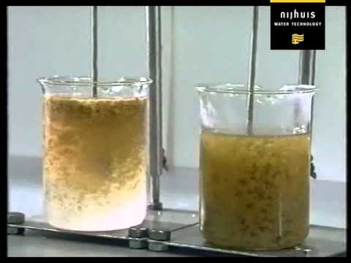

Slide 24

After flocculation, the water is filtered to remove floc, solid particles and other suspended objects.
Sterilisation happens next. A chemical called chlorine is added to the water to kill any bacteria. Chlorine is also put into swimming pools to kill germs.
Finally, fluoride is added to the water in a process called fluoridation. This chemical helps prevent tooth decay.

